Slide 1
Introduction to Computer Programming Lecture 5.1:
Classes in Python
Hemma Philamore
Department of Engineering Mathematics

Slide 2
Introduction to Computer Programming Lecture 5.1.a:
Intro to Classes in Python
Hemma Philamore
Department of Engineering Mathematics

Slide 3


What are classes?
Usually we think of variables and functions as separate entities.
Variables
Functions
B = ”hello”
C = (4, 5, 9)
D = [3, 5, 6, 7]
print( B )
type( C )
len ( D )

Slide 4
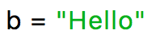





What are classes?
Variables have functions that can be executed using a dot ( . ).
The functions that can be used depend on the variable type.
Functions for tuple:
c.count()
c.index()
Variables
Functions
Functions for list:
d.count()
d.index()
d.append()
d.extend()
d.insert()
d.remove()
d.pop()
d.clear()
d.sort()
d.reverse()
print( b, c, d )

Slide 5
What are classes?
Variables have functions that can be executed using a dot ( . ).
The functions that can be used depend on the variable type.
Functions for tuple:
c.count()
c.index()
Variables
Functions
Functions for str:
b.find()
b.capitalize()
b.isalpha()
.
.
.
many, many more.…

Slide 6
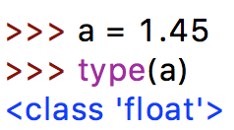
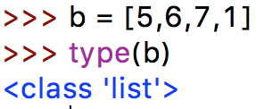

What are classes?
A class can be seen as combing values and corresponding functions in one entity!
MyOwnClass
Variables
Functions
Python is special: All build-in data
types are “classes”!
Disclaimer: Note that the idea of classes (object orientated programming) is much more complex (inheritance, encapsulation, polymorphism, etc.)

Slide 7
Let’s make our own class
Example: We want to build a class that represents fractions.
numerator
2
denominator
3
Possible functions:
get float value
print out nicely
get numerator
get denominator
get fraction from float
mathematical functions (addition, multiplication, …)
class specific
functions

Slide 8
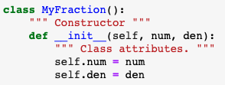
Let’s make our own class
Class name
Convention: begin with capital letter
Keyword ‘class’
parentheses
colon
Indentation
Constructor:
Runs automatically when a class object is created
Notes:
Wrong of what goes in arguments start from this point again

Slide 9
Let’s make our own class
Constructor:
Must be named __init__ (note the two underscores (_) before and after
Must be called on 2nd line of class
Must take self as an input parameter
defined on 2nd line of class
1st argument is ‘self’
(required)
Input Arguments when a class object is created (optional)
Class attributes:
Variables belonging to the class

Slide 10
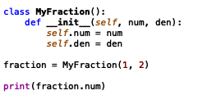
Let’s make our own class
self. behaves like the pronoun 'my’
('my', means someone totally different when said by someone else)
Inside the class: self.num (my num , my den)
Outside of the class: my_fraction.num
1
Notes:
Anotations accidentally left on slide, stop video

Slide 11
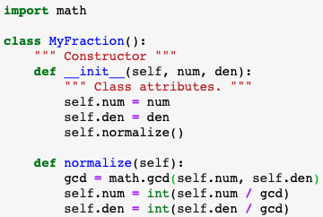

Let’s make our own class
Methods:
Functions belonging to the class
NOTE : Class methods can
be called inside of other
methods, including __init__
1st argument is ‘self’
Attribute names begin with ‘self.’

Slide 12
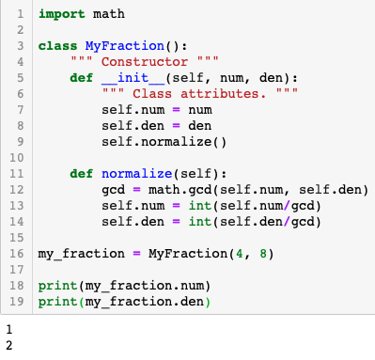
self. behaves like the pronoun 'my’
Inside the class, we are talking about my num , my den → self.num
Outside of the class → my_fraction.num
('my', means someone totally different when said by someone else.)
Normalized values of num and den

Slide 13
Introduction to Computer Programming Lecture 5.1.b:
Classes in Python: Redefining Built-in Functions
Hemma Philamore
Department of Engineering Mathematics

Slide 14
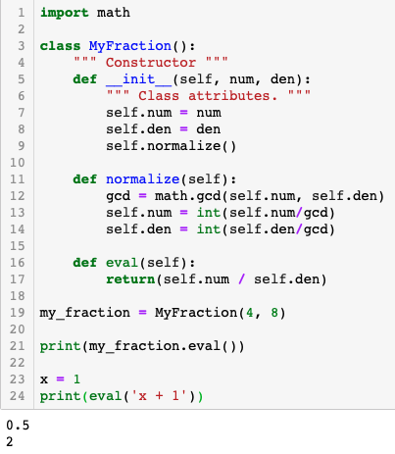
Re-definition of built-in function for this class
Class method .eval()
Built in function eval(…) still works normally

Slide 15
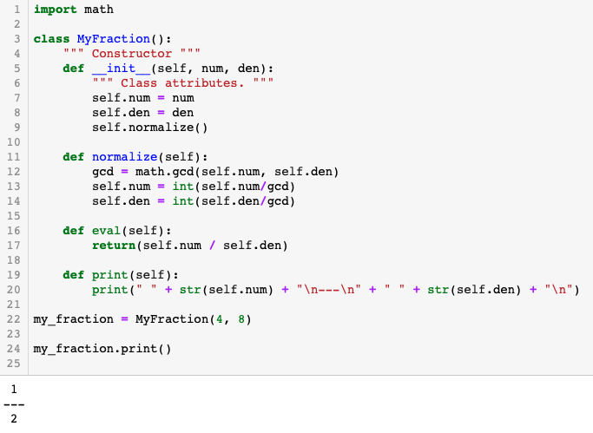
We could define a class method print….
…but it would be annoying to need to remember to write <item_to_print>.print() when we are already used to writing print as print(<item to print>).
Instead…

Slide 16
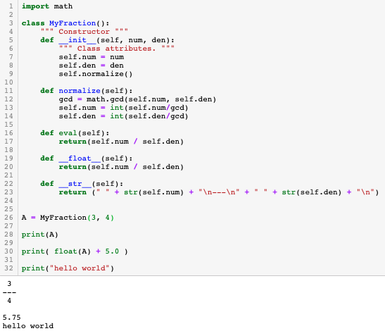
Double underscore ( __ ) used to overwrite built-in functions for this class, when called normally
print function uses a string –
__str__ will be called
__float__ will be called
print can be used as normal for
regular operations
Notes:
Fucked up explaining add, retake

Slide 17
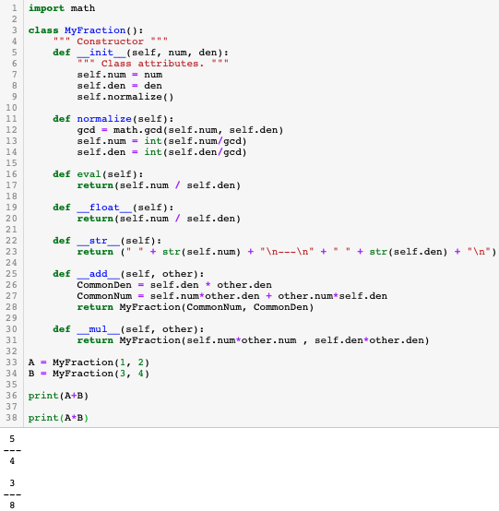
__add__ will be called
__mul__ will be called

Slide 18
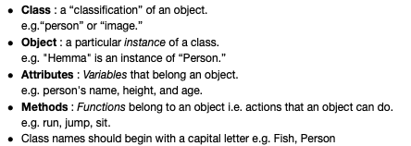
Summary

